Slide 1
Final project presentation
By:Hadeel Sameh

Slide 2
We have three tasks represents the three messages (door ,light, speed)
Speed message has periodicity of 5ms and assumed duration 1ms.
Door message has periodicity of 10ms and assumed duration 2ms.
Lights message has periodicity of 20ms and assumed duration 3ms.
So speed M is the highest priority as it has lowest duration ,and the lowest priority is light message as it has the longest duration and lowest periodicity
Bus load =(the sum of the division(message length /message periodicity ))/bode rate

Slide 3
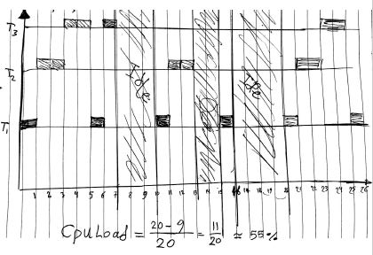
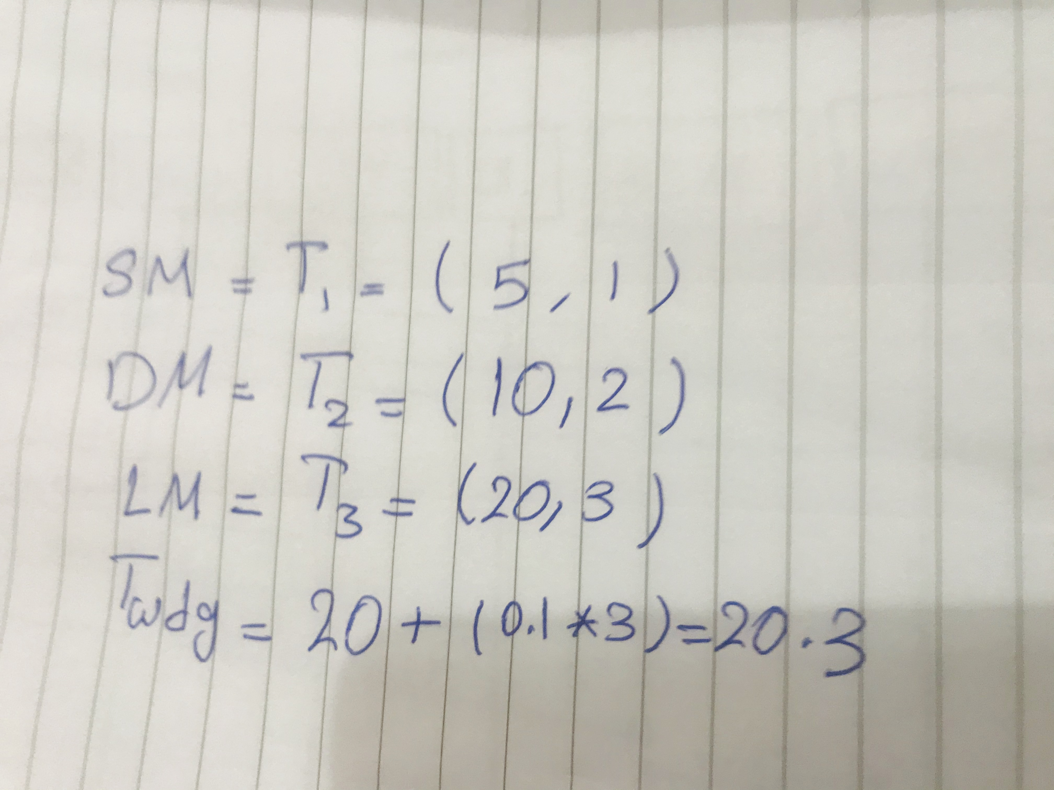
The following figures shows tasks works depending in system tics:
We see that the system reset after 20 tic

